Slide 1




1
z
Decentralized Task Management System

Slide 2
Introduction
z
"Allow us to introduce our dedicated team behind the Decentralized Task Management System on Hedera Hashgraph project. Comprising diverse expertise in blockchain technology, software development, and user experience design, our team is passionate about revolutionizing task coordination. With a shared vision for transparency, security, and global accessibility, we're committed to reshaping how tasks are managed in the digital age."
Pranadeep
K Rakesh
Umesh Chandra

Slide 3
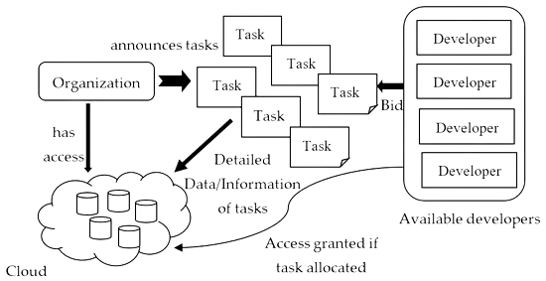
Objective
2
The objective of our Decentralized Task Management System on Hedera Hashgraph is to create a secure and transparent platform that empowers teams and individuals to collaborate efficiently on tasks and projects. By leveraging the benefits of DLT and Web3 technologies, our goal is to enhance productivity, accountability, and trust within teams, while providing a decentralized and tamper-resistant environment for task management.

Slide 4
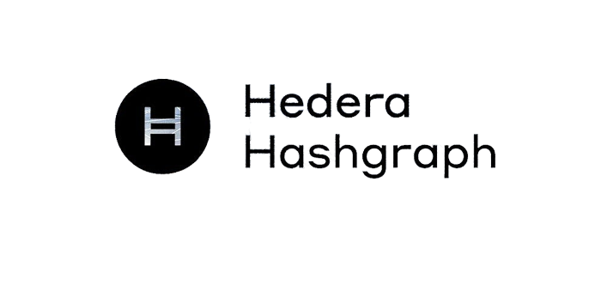
Hedera Harshgraph
3
Hedera Hashgraph is a distributed ledger technology (DLT) that aims to provide a secure, fast, and efficient platform for decentralized applications (DApps) and services. Unlike traditional blockchains, which rely on Proof of Work (PoW) or Proof of Stake (PoS) consensus mechanisms, Hedera Hashgraph uses a unique consensus algorithm called the Hashgraph Consensus Algorithm. This algorithm combines the concepts of gossip protocols and virtual voting to achieve fast, fair, and Byzantine fault-tolerant consensus.

Slide 5

WHAT IS DECENTRALIZATION?
4
A decentralized system is a network or infrastructure in which decision-making authority, control, and data distribution are distributed across multiple nodes or participants, rather than being concentrated in a central authority or entity. In a decentralized system, participants work collaboratively to achieve common goals without the need for intermediaries.

Slide 6





Tools Used in Project
Programming Languages:
Solidity
JavaScript/TypeScript
HTML/CSS
Development Frameworks:
Hedera JavaScript SDK
React.js
Node.js
Smart Contract Development:
Hedera Smart Contracts
Hedera Token Service (HTS)
Database:
Hedera Hashgraph Distributed Ledger
IDE (Integrated Development Environment):
Visual Studio Code
Deployment and Hosting:
Cloud Platforms
Testing and Debugging:
Hedera Hashgraph Test net
Documentation and Learning:
Hedera Hashgraph Documentation

Slide 7

6
Advantages
Decentralization and Trustlessness
Eliminates central control, enabling direct peer-to-peer interactions without intermediaries.
Enhanced Security
Utilizes Hedera Hashgraph's tamper-proof consensus for secure task data storage.
Transparency
Provides a transparent, auditable history of task assignments and progress.
Global Accessibility
Enables task management from anywhere, ideal for remote teams and collaborations.
Efficiency and Automation
Smart contracts automate task processes, reducing manual effort.
Reduced Intermediaries
Eliminates middlemen, ensuring faster and cost-effective task interactions.
Data Privacy
Prioritizes encrypted, secure communication for sensitive task information.
User-Friendly Design
Intuitive interface for easy task creation, assignment, and tracking.
Scalability
Hedera Hashgraph's high throughput handles numerous tasks and users efficiently.
Future-Proofing
Adopts decentralization and advanced tech, staying relevant in evolving trends.
Empowering Collaboration
Fosters ownership and inclusivity among distributed teams.
Open Ecosystem
Allows collaboration and integration with other Hedera Hashgraph services.
Resilience
Reduces vulnerability to single points of failure, ensuring system robustness..

Slide 8
7
Content
High-Level Architecture:
The system's architecture ensures efficient task management and interactions.
Nodes and Validators:
Nodes are participants; validators verify transactions for consensus.
User Roles:
Creators initiate tasks, assignees complete, verifiers validate.
Decentralized Consensus:
Consensus mechanism validates transactions and task states.
Smart Contracts:
Automate rules and conditions for tasks.
Data Distribution:
Data redundancy for reliability and fault tolerance.
Communication Protocols:
Secure data transmission among nodes.
Hedera Hashgraph Integration:
Leveraging Hashgraph's consensus and network.
Scalability and Performance:
Efficiently scales with task and user growth.
User Experience Focus:
Intuitive interface for easy task management.

Slide 9
User Experience
z
Intuitive Task Management:
Simplified steps for easy task handling.
Creating Tasks:
Add tasks with details and due dates.
Assigning Tasks:
Allocate tasks to participants.
Tracking Progress:
Real-time updates on task status.
Completing Tasks:
Mark tasks as done, validated by verifiers.
Transparency and Accountability:
Transparent actions on immutable ledger.
Real-Time Updates:
Timely notifications for changes.
User-Centric Interface:
Simple design for all users.
Efficient Communication:
In-system communication for streamlined interactions.
Secure Authentication:
Strong access protection.
Empowering Collaboration:
Enhances teamwork and productivity.

Slide 10
Security Measures
z
Ensuring Security:
Top priority for data and interactions.
Encrypted Communication:
Secure data exchange through encryption.
Access Control:
Authorized user interactions only.
Multi-Factor Authentication (MFA):
Multiple verification layers for access.
Immutable Ledger:
Hedera Hashgraph prevents data tampering.
Audit Trails:
Traceable history for accountability.
Regular Security Audits:
Periodic vulnerability assessments.
Smart Contract Auditing:
Comprehensive contract reviews.
Penetration Testing:
Identifying weak points through simulated attacks.
Data Encryption at Rest:
Data security even when inactive.
Privacy Protection:
Sharing task details only with authorized users.
Ongoing Monitoring:
Swift detection of suspicious activities.
User Education:
Promoting security awareness.
Regulatory Compliance:
Adhering to data protection regulations.

Slide 11
Future Enhancements
z
Continual Development:
System designed for ongoing improvements.
Platform Integration:
Integrate with other platforms for expanded features.
Smart Contract Automation:
Automate tasks through advanced smart contracts.
AI-Driven Recommendations:
AI suggests optimal task assignments.
Enhanced Reporting:
Detailed task performance insights.
Advanced Notifications:
Improved updates and reminders.
Decentralized Identity:
Enhanced authentication and privacy.
Collaboration Tools:
Seamless integration for communication.
Decentralized Governance:
User-driven platform upgrades.
Scalability Focus:
Optimize for growing user bases.
Customization Options:
User-defined task views and workflows.
Mobile Support:
Cross-device compatibility.
Gamification Elements:
Engagement-enhancing features.
File Storage Integration:
Secure storage for task-related files.
User Feedback:
Input drives iterative enhancements.

Slide 12

Global Accessibility
z
Worldwide Reach:
System accessible to users globally.
Hedera Hashgraph's Presence:
Leverage global Hedera Hashgraph network.
Borderless Decentralization:
Tasks managed across geographical borders.
Cross-Cultural Collaboration:
Diverse users collaborate seamlessly.
Time Zone Flexibility:
Efficient coordination in different time zones.
Economic Inclusion:
Empowerment regardless of economics or location.
Language Localization:
Potential for diverse linguistic support.
Unified Experience:
Consistency fosters unity among users.
Breaking Barriers:
Reduces global cooperation barriers.
Innovation Catalyst:
Encourages diverse, innovative task management.

Slide 13
z
Conclusion
Recap of Key Points:
The Decentralized Task Management System offers numerous advantages for efficient and secure task coordination.
Benefits of Decentralized Task Management:
Enhanced transparency, security, and collaboration redefine task management practices.
Role of Hedera Hashgraph:
Leveraging Hedera Hashgraph's consensus ensures a reliable and robust foundation for the system.
Future Potential:
The system's adaptability and potential for expansion pave the way for innovative enhancements.
Pioneering Change:
By embracing decentralization, the project leads the way toward a more inclusive and efficient future.
Empowerment Through Technology:
Users gain control over tasks in a borderless environment, irrespective of geographical boundaries.
Continuous Evolution:
As the system evolves, it sets the stage for an agile, collaborative, and secure task management landscape.

Slide 14

z
Thank you
"Thank you for being a part of our presentation. Your interest is truly appreciated. We look forward to the positive impact of the Decentralized Task Management System on Hedera Hashgraph. Stay connected for updates and future collaboration opportunities. Your engagement fuels our commitment to innovation in task management."

